Slide 1




DAMG 6210
STUDENT
MARKETPLACE
Dhruv Sunil Parmar
Dilip Sharma
Robin Ignatious
Sai Kashyap Cheruku Nishita Vikas Shewale
Submitted to: Prof. Manuel Montrond

Slide 2

Project
Overview
The Student Marketplace is a digital platform designed to create a vibrant and sustainable ecosystem within the student community, offering a convenient space for students to buy and sell various items, including textbooks, electronics, furniture, and fashion. This marketplace aims to streamline the process of transactions, foster community engagement, and support the financial well-being of students by providing an accessible and user-friendly platform.

Slide 3




Tools Used
Tableau
Tableau is a data visualization tool used for converting raw data into an understandable format, primarily in the form of interactive and shareable dashboards.
Streamlit
Streamlit enables the creation of interactive web GUIs for database CRUD operations, allowing users to easily manage and interact with database data through a web interface built with Python code.
SQL
SQL (Structured Query Language) is a standard programming language used for managing and manipulating relational databases. It allows for storing, querying, updating, and deleting data, as well as managing database schemas

Slide 4
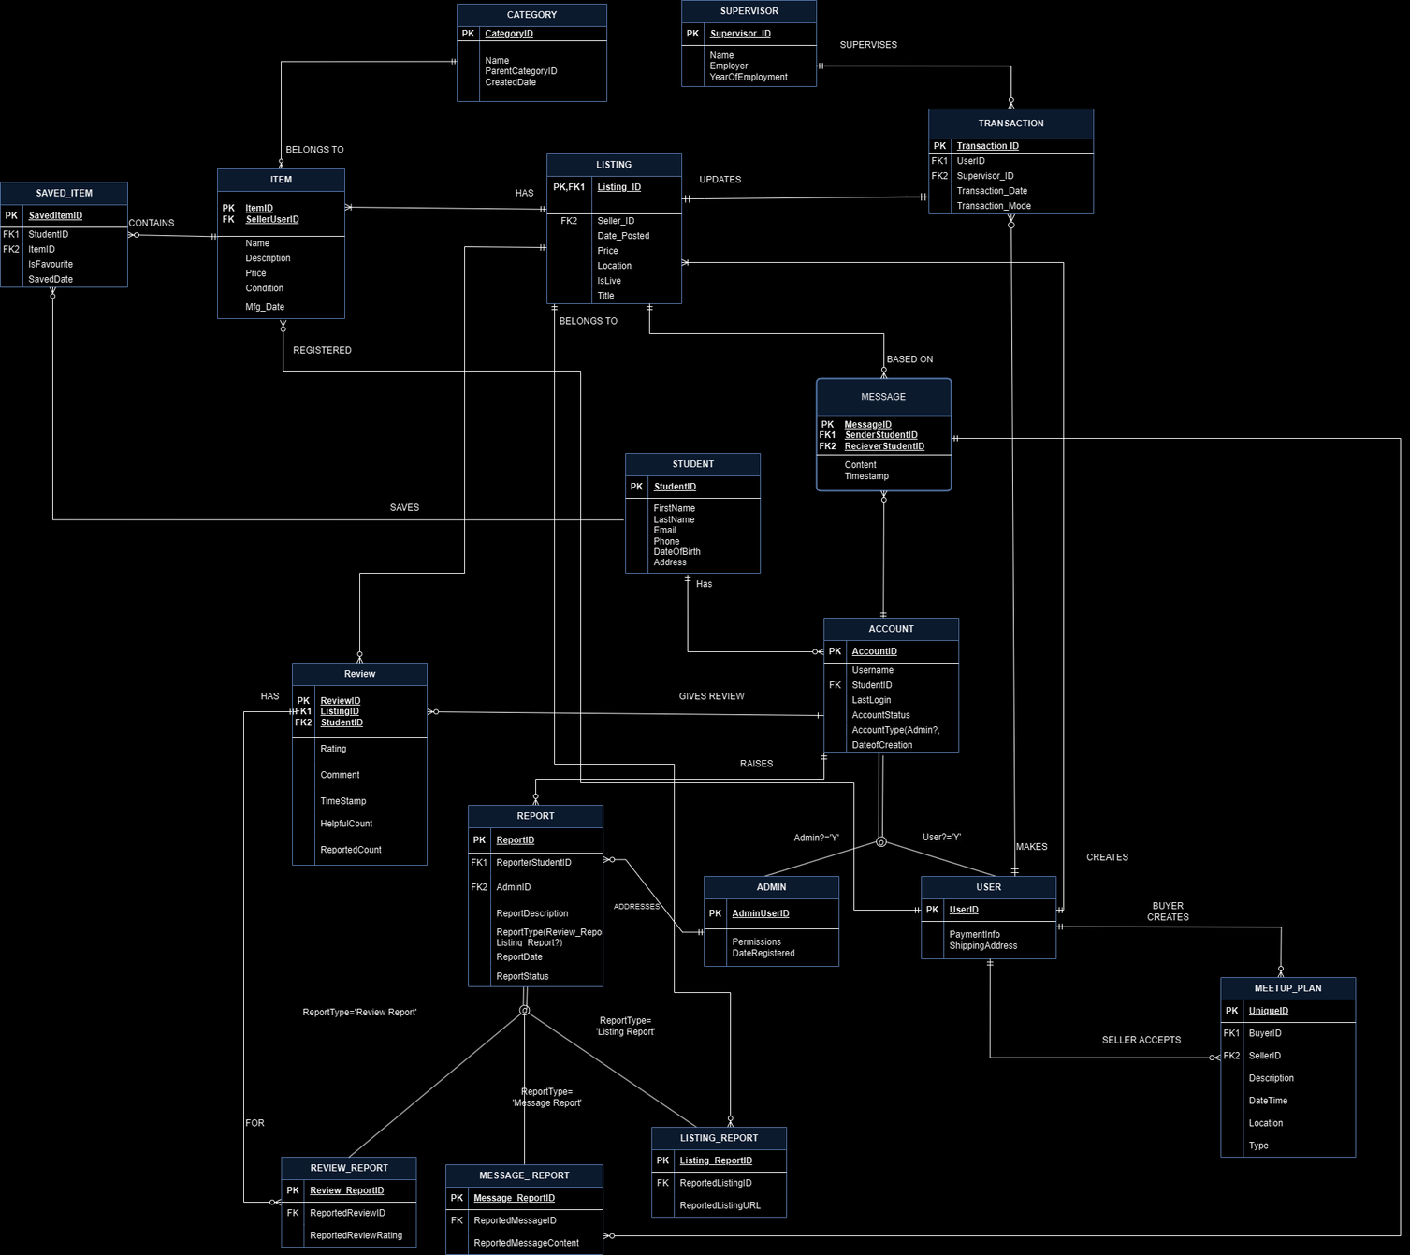
ERD

Slide 5
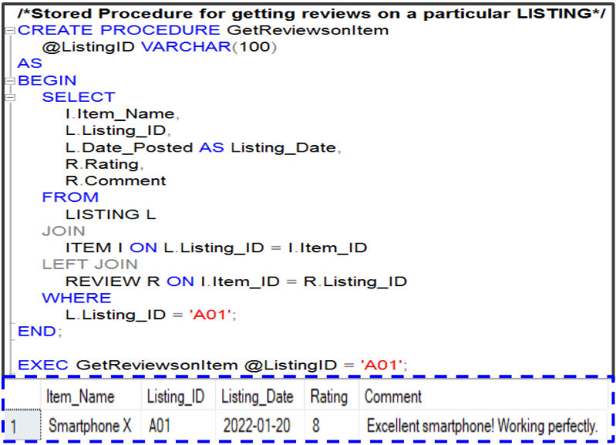
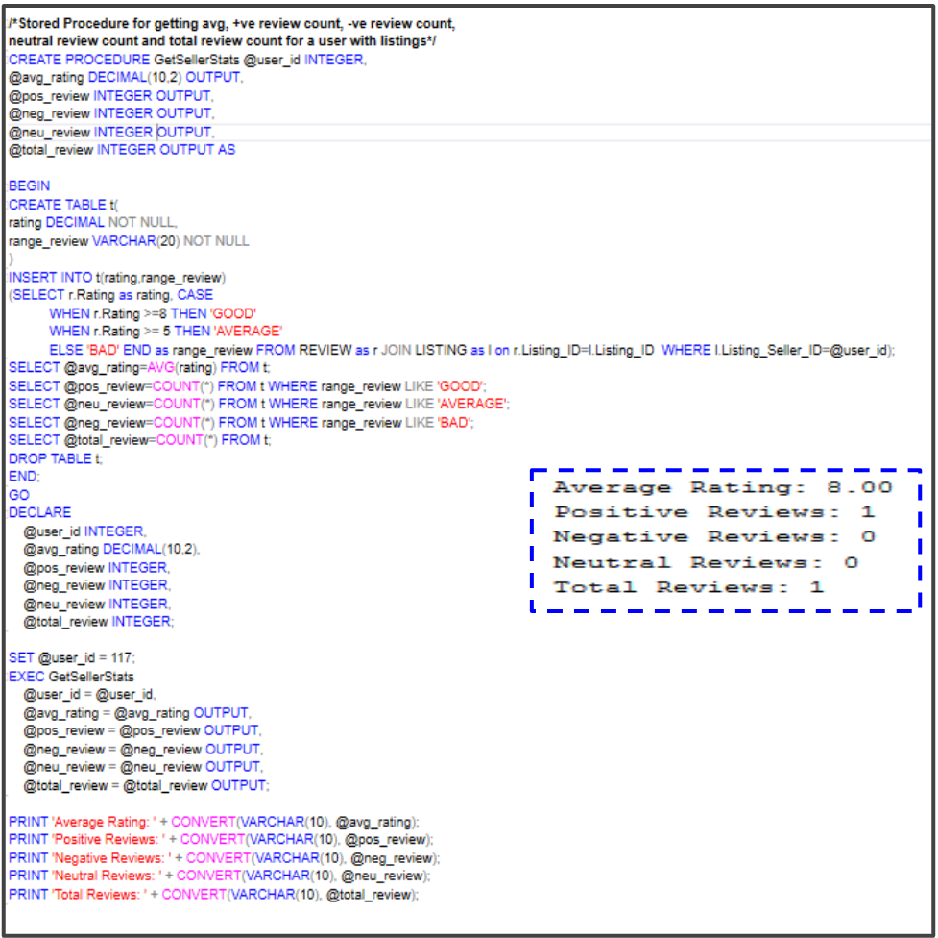
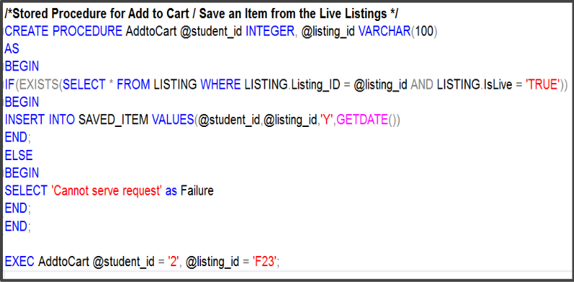
STORED PROCEDURES

Slide 6
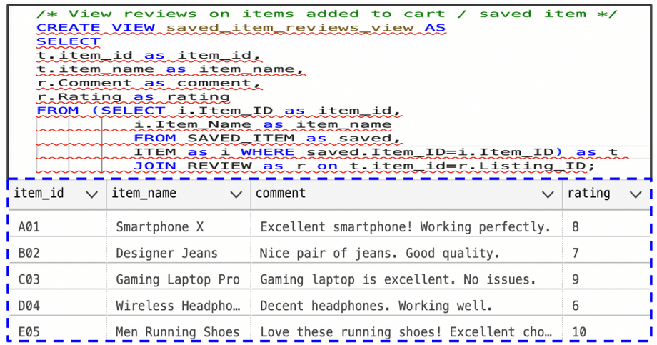
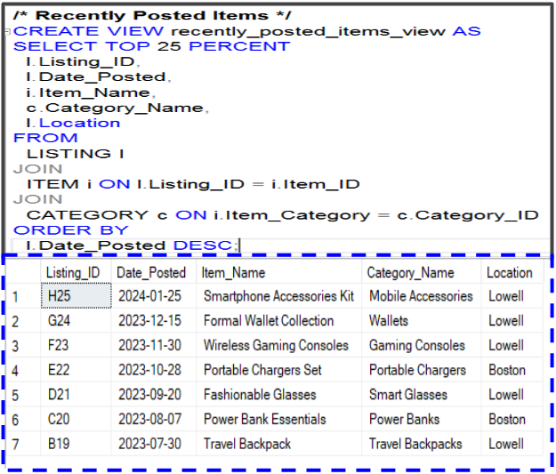
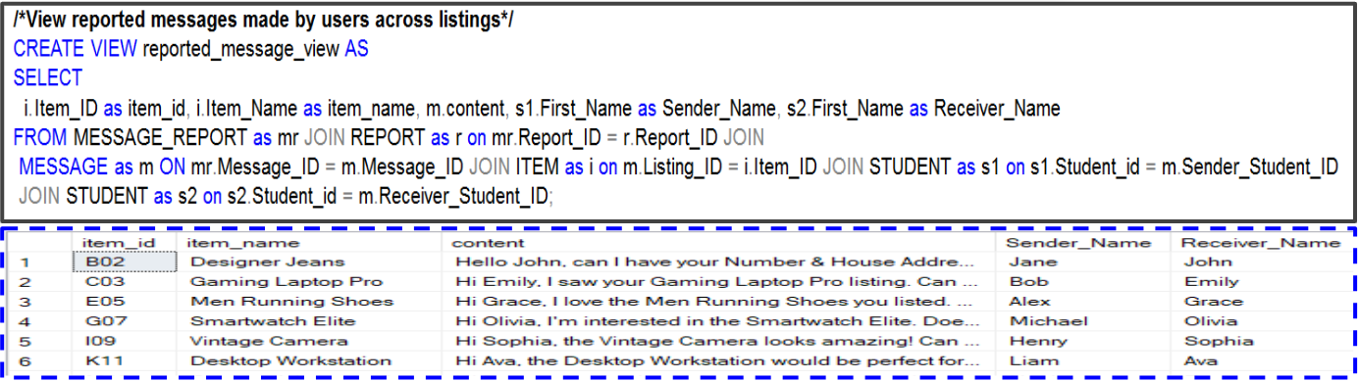
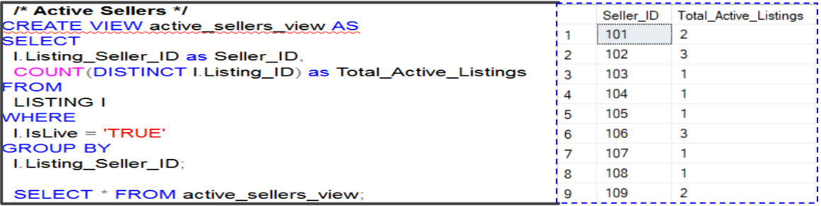
VIEWS

Slide 7
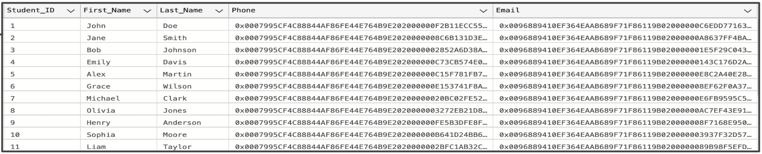
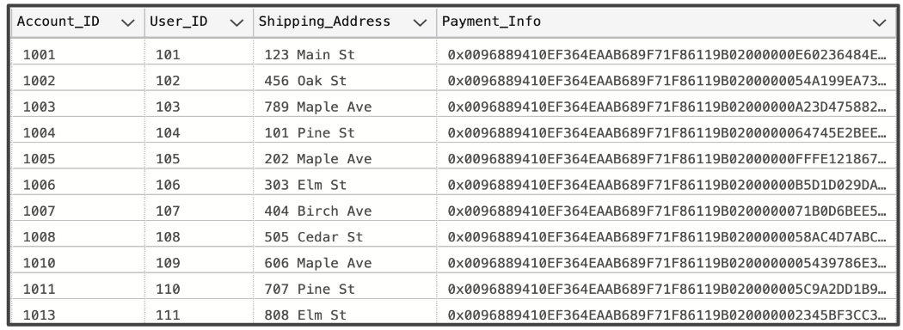
DATA ENCRYPTION ON PERSONALLY IDENTIFIABLE INFORMATION
Student Table (Phone,Email)-
User Table (Payment Info)-

Slide 8
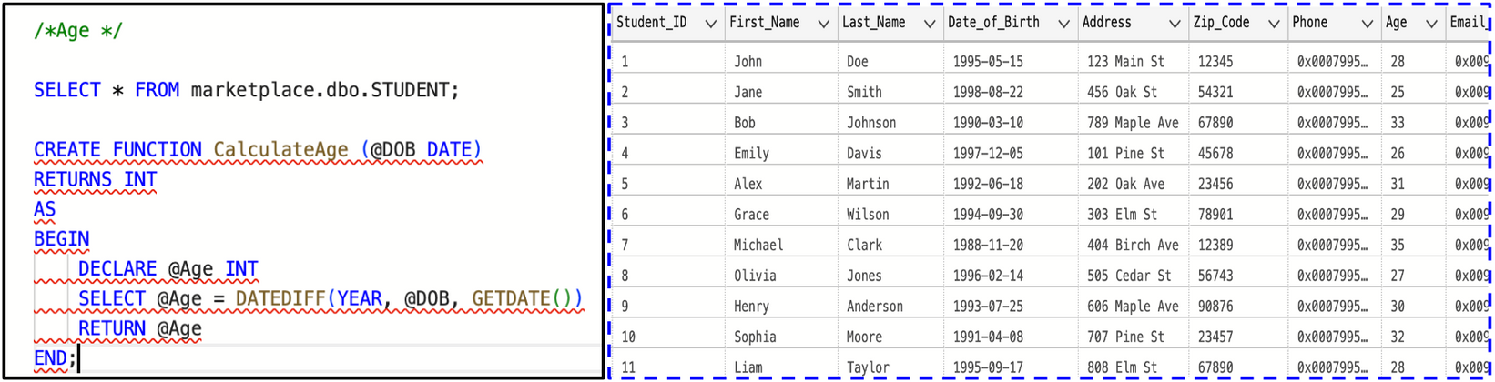
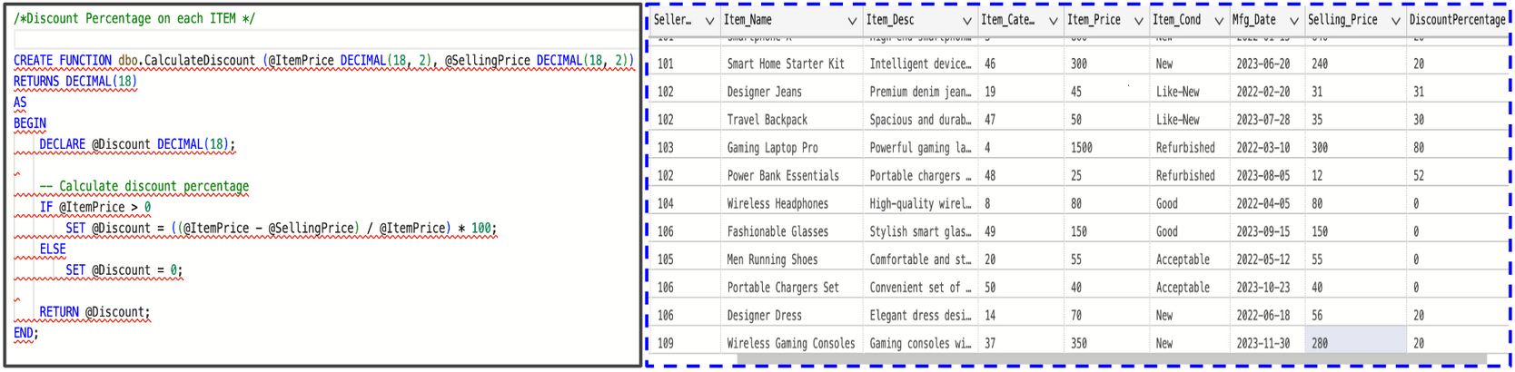
USER DEFINED FUNCTIONS

Slide 9
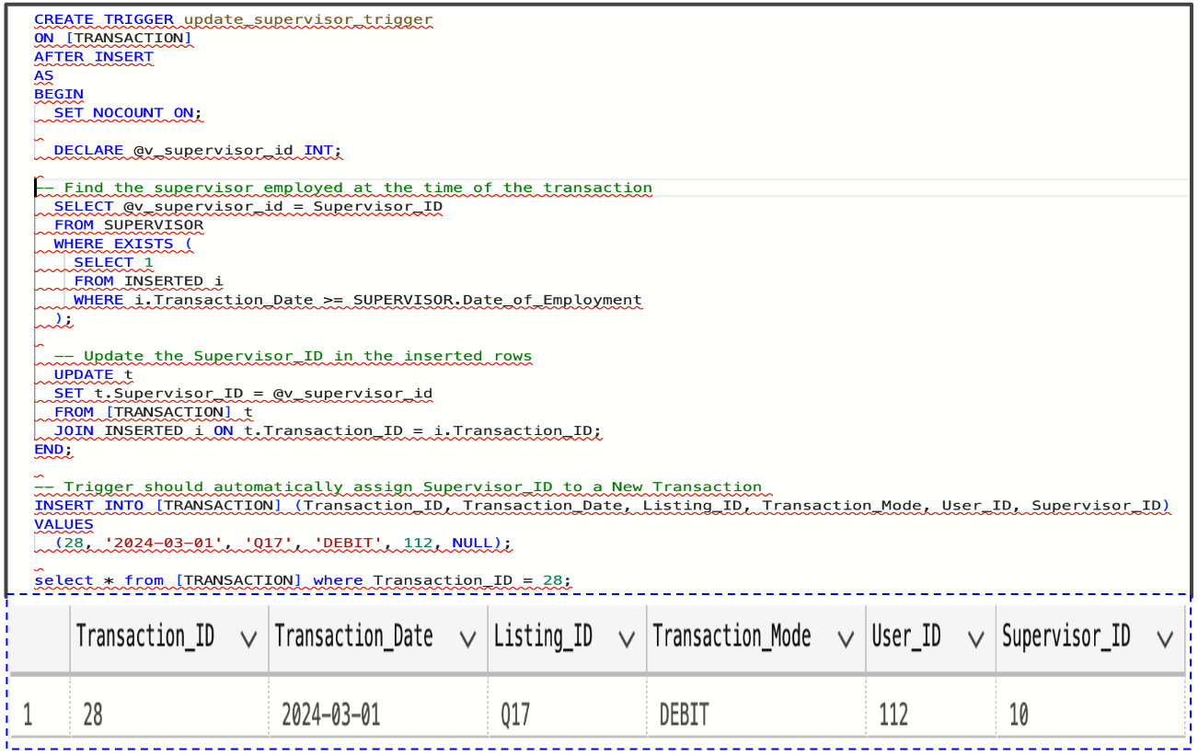
TRIGGERS

Slide 10
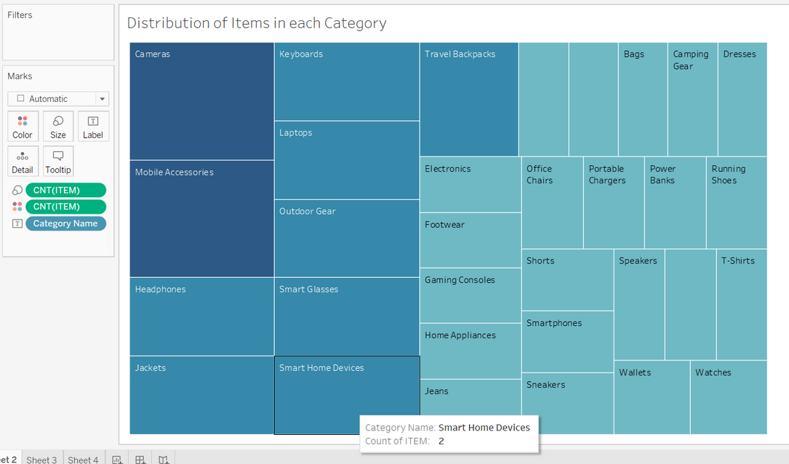
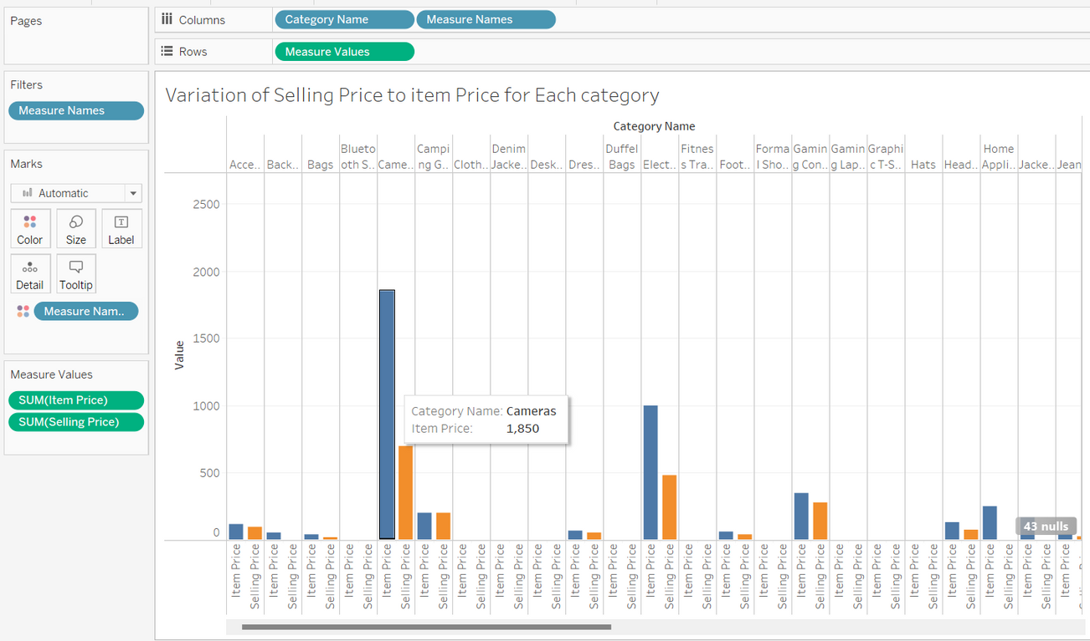
DATA VISUALIZATION USING TABLEAU

Slide 11
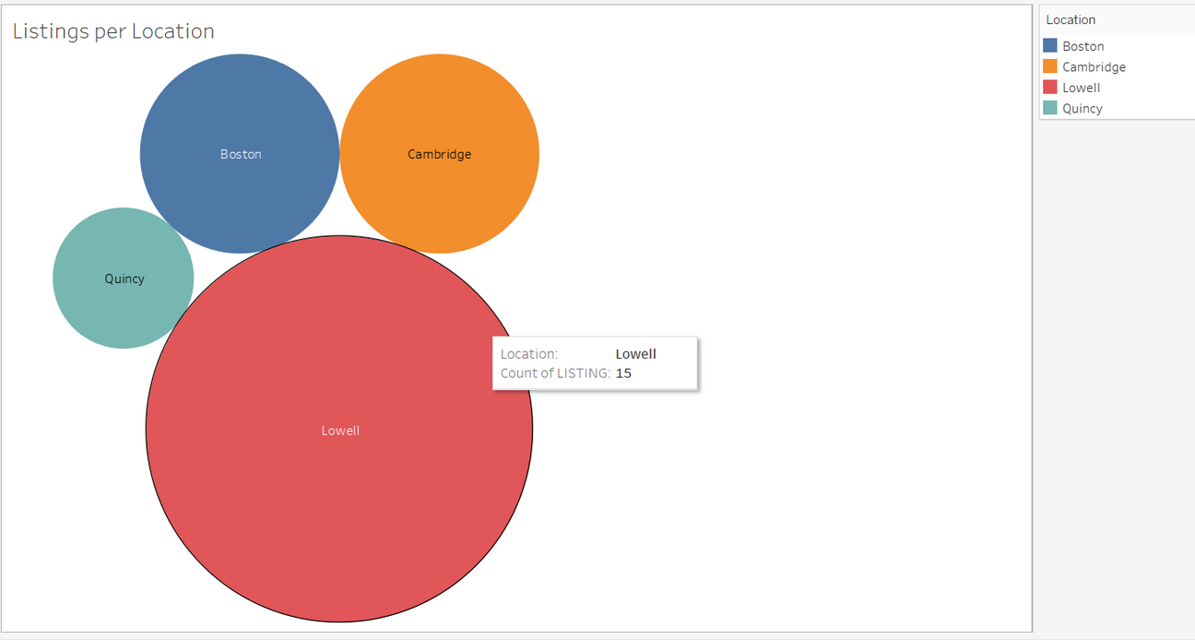
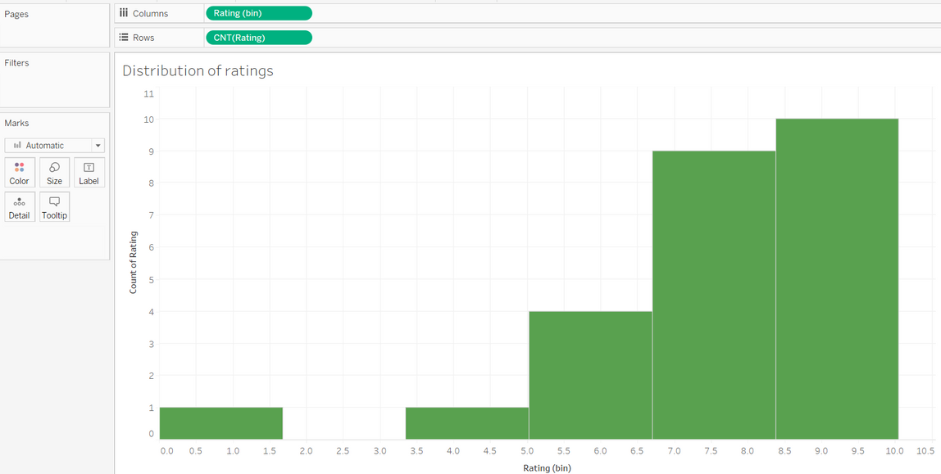
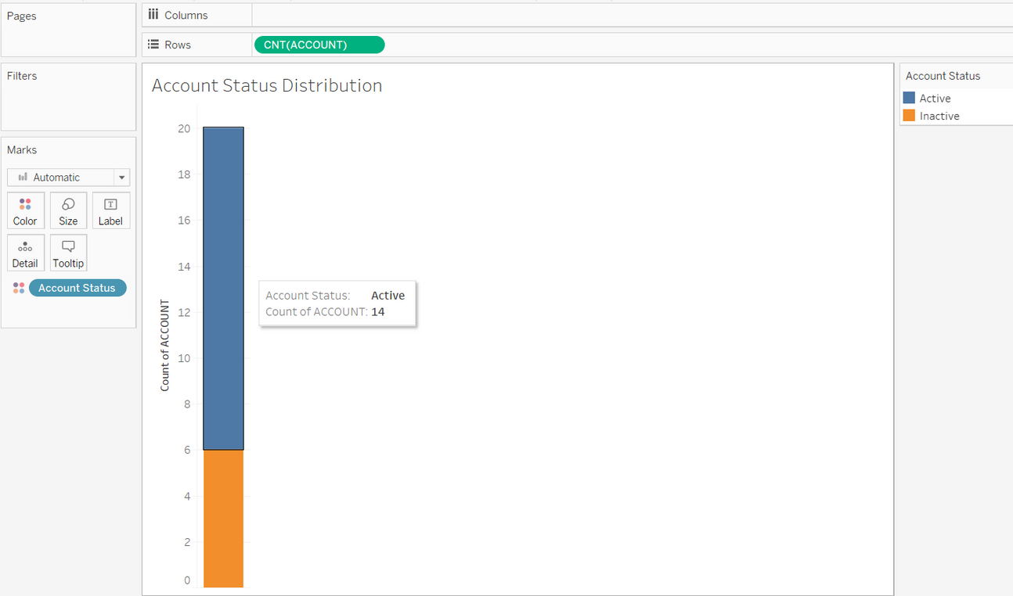

Slide 12

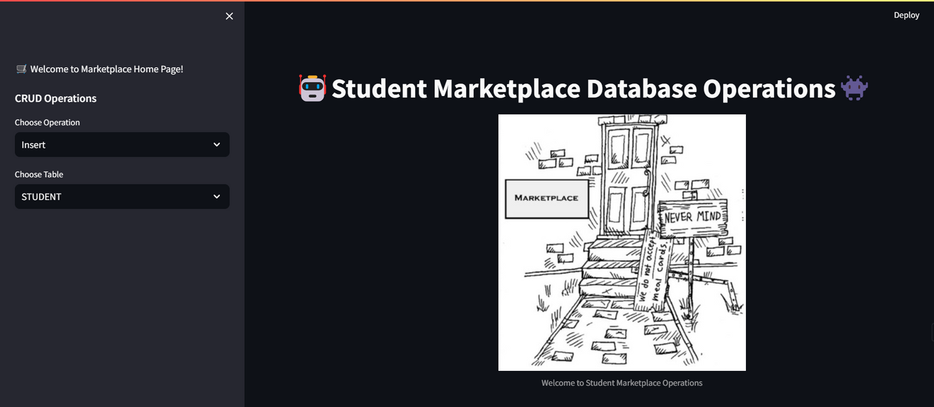
GUI- STREAMLIT
HOME PAGE

Slide 13
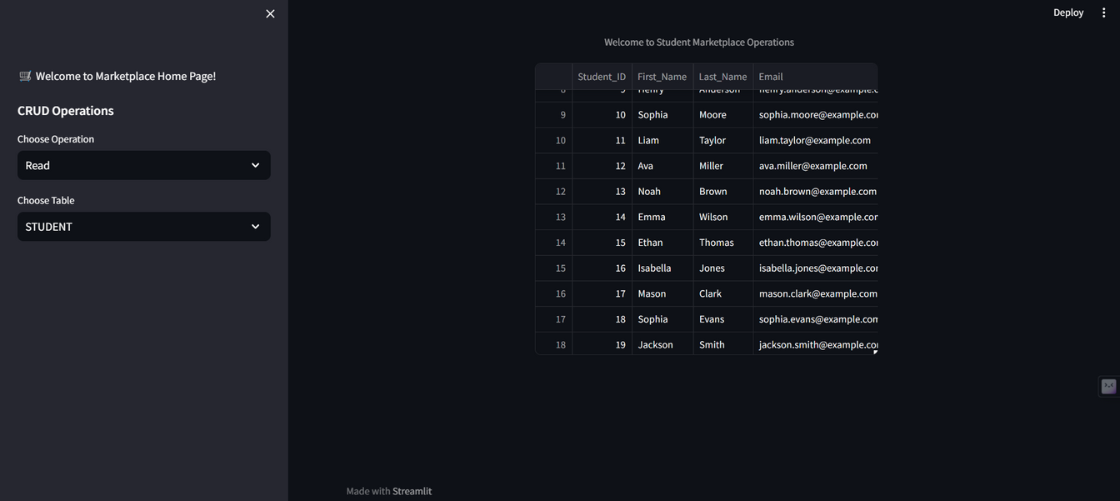
GUI- STREAMLIT
CRUD PAGE

Slide 14
THANK
YOU

